Slide 1
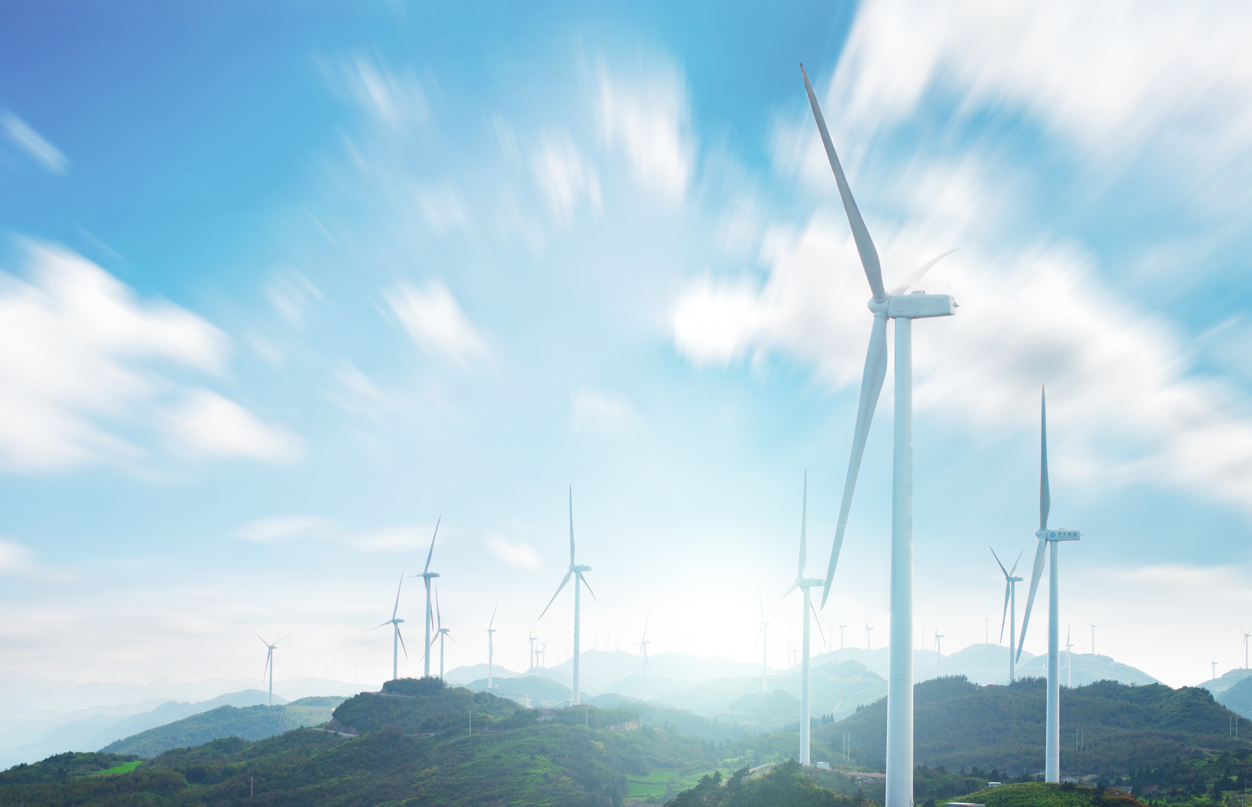

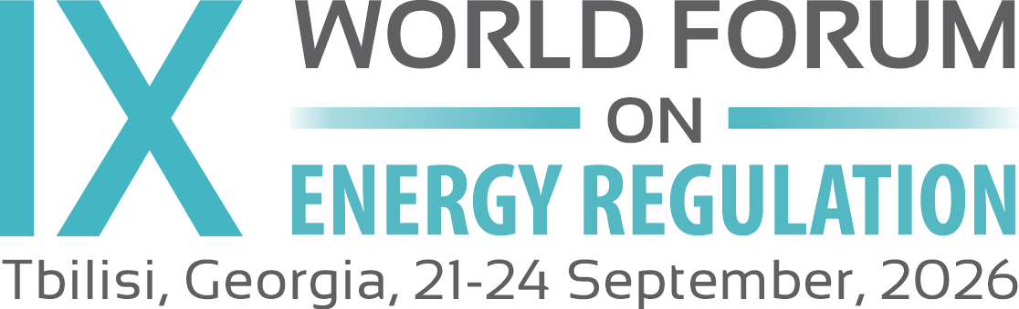
CONSUMER INTEGRATION IN THE SMART GRID
Energy Conservation 2.0
Turning smart-grid technology into consumer and system value
Plenary 3
Technology as a Driver of Energy Transformation
Dr. Márcio Venício Pilar Alcântara
Brazilian Electricity Regulatory Agency — ANEEL
Tbilisi, Georgia · 24/ September /2026

Slide 2

CORE MESSAGE
Technology enables the energy transition. Adaptive regulation converts technological capability into consumer, market and power-system value.
THE TRANSITION, IN THREE STAGES
STAGE 1 · TODAY
STAGE 2 · EMERGING
STAGE 3 · GOAL
Passive consumer, one-way grid
Smart grid, active prosumer
Flexible, resilient, sustainable system
Centralised generation and a unidirectional network serving passive demand.
Two-way power and data, solar PV, storage, EVs and home automation.
Aggregated flexibility, high renewables and coordinated operation.
The technology already exists.
The unresolved issue is consumer integration.
Regulation decides whether distributed capabilities become system resources.
Tbilisi, Georgia · September 2026
Notes:
The technology for the transition already exists; the unresolved question is consumer integration, and regulation decides whether distributed resources become genuine system resources. Walk the three stages left to right: passive one-way grid today, active prosumer emerging, flexible coordinated system as the goal.

Slide 3

THE ARCHITECTURE
The EC 2.0 Ecosystem
Aggregation · Smart Microgrids + Virtual Power Plants
CROSS-CUTTING ENABLING LAYERS
Four layers wrap the whole ecosystem.
PILLAR 1
01
AI Fabric
Advanced Energy Efficiency
Shared intelligence linking every resource.
02
Flexible Market Interface
Access to energy and flexibility markets.
CORE
Consumer / Prosumer
03
Cybersecurity & Privacy by Design
PILLAR 2
PILLAR 3
A secure, trustworthy data foundation.
Demand-Side Integration & Flexibility
Distributed Energy Resources
04
Behavioral Engagement
Sustained, informed consumer participation.
Coordination · AI-Enhanced Dynamic Energy Management
TAKEAWAY
EC 2.0 integrates efficiency, flexibility, generation and storage as one system — not as separate policies.
Notes:
The architecture. At the centre sits the consumer/prosumer. Three integrated resource pillars surround them — efficiency, demand-side flexibility, and distributed generation and storage. AI-enhanced dynamic energy management coordinates those resources; microgrids and virtual power plants aggregate them into the system. Four cross-cutting layers wrap everything: the AI fabric, the market interface, cybersecurity and privacy, and behavioural engagement. The point: EC 2.0 treats these as one integrated system, not separate policies.
AI Fabric is a distributed intelligence layer that connects data, analytical models and operational decisions across all levels of the energy system.

Slide 4
THE EVIDENCE
Quantified System Value
SCALE 01 · ONE HOME
SCALE 02 · HOME + SOLAR
SCALE 03 · SYSTEM
Efficient Home
Efficient Home + Solar PV
Coordinated Neighborhood 300 homes
−35%
−52%
−28%
Daily energy consumption
Grid consumption with 8 m² of PV, vs. base case
Aggregate energy consumption
−61%
Peak demand
WITH 32 M² PV · NET PROSUMER
−27% to −41%
20.96
18.62
0.29 → 0.54
kWh exported
vs
kWh imported
Peak demand
Load factor
GridLAB-D simulations reported in Alcântara (2014). Results reflect the modelled data, technologies and assumptions available at that time.
Integrated conservation does more than save energy — it reshapes the load curve and raises the utilisation of existing network assets.
TAKEAWAY
Notes:
The evidence, from GridLAB-D simulations. At the single home, integrated efficiency cuts daily consumption about 35% and peak demand 27 to 41%. Add rooftop solar and grid consumption falls 52% with just 8 square metres; at 32 square metres the home becomes a net prosumer — exporting more than it imports. Coordinate 300 homes and aggregate consumption drops 28%, peak demand 61%, and the load factor nearly doubles. The story isn't just saved energy — it's a reshaped load curve and far better use of existing network assets.

Slide 5
THE RULES
Adaptive Regulatory Framework
01
Revenue Model
02
New Market Actor
03
Digital Verification
Revenue–volume decoupling. Dynamic, value-based remuneration by time and location.
ARAC — the Adaptive Resource Aggregator for Conservation.
AI-enabled M&V 2.0 — granular AMI data, counterfactual baselines, automated verification.
Verified Flexibility
as a power-system resource
06
Digital Trust
05
Consumer & Social Safeguards
04
Market & System Operation
Data governance, privacy-by-design and zero-trust cybersecurity.
Transparency, interoperability, data portability, equity and a just transition.
Neutral DSO with local flexibility markets and TSO–DSO coordination.
TAKEAWAY
Regulation must reward efficient network operation and verified system value — not electricity sales volume alone.
Notes:
The regulatory architecture. At the centre is the goal: verified flexibility treated as a genuine power-system resource. Six mechanisms make that possible — a revenue model that decouples earnings from volume; a new market actor, the ARAC aggregator; digital verification through AI-enabled measurement and verification; neutral system operation with local flexibility markets and TSO-DSO coordination; consumer and social safeguards; and digital trust. The message: regulation must reward efficient network operation and verified system value, not electricity sales volume alone.

Slide 6
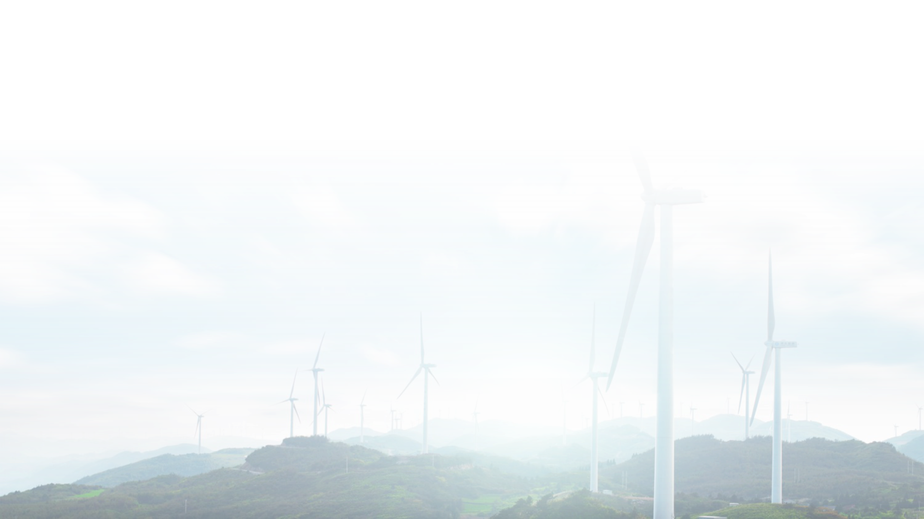
THE OUTCOME
From Technology to Energy Sustainability
A CLOSED VALUE-CREATION CYCLE
01
02
03
04
05
Smart-grid technology
Active & protected consumers
Aggregated & verified flexibility
System & market value
Sustainable investment signals
The loop closes: investment signals feed back into technology and participation.
ENVIRONMENTAL
ECONOMIC
SOCIAL
More efficiency and renewable integration. Lower emissions and peak generation.
Lower system costs. Deferred infrastructure investment. New services and innovation.
Consumer empowerment. Resilience. Inclusion and equity.
CLOSING
The decisive innovation is not the device itself. It is the regulatory architecture that allows distributed consumer resources to become reliable, measurable and fairly remunerated power-system resources.
Energy Conservation 2.0 · Márcio Venício Pilar Alcântara · ANEEL
When Balance Is Achieved
Notes:
Closing. This is a closed value-creation loop: smart-grid technology enables active, protected consumers; their resources aggregate into verified flexibility; that flexibility creates system and market value; which produces sustainable investment signals that flow back into technology and participation. The outcomes are environmental, economic and social. And the closing thought: the decisive innovation is not the device — it is the regulatory architecture that turns distributed consumer resources into reliable, measurable and fairly remunerated system resources. Technology will transform the electricity sector; the regulator's task is to ensure that this transformation produces public value.

Slide 7
Regulate for Flexibility.
Design for Trust.
Deliver Public Value.
Turn distributed consumer resources into reliable, measurable and fairly remunerated power-system assets.
Energy Conservation 2.0

